Slide 1
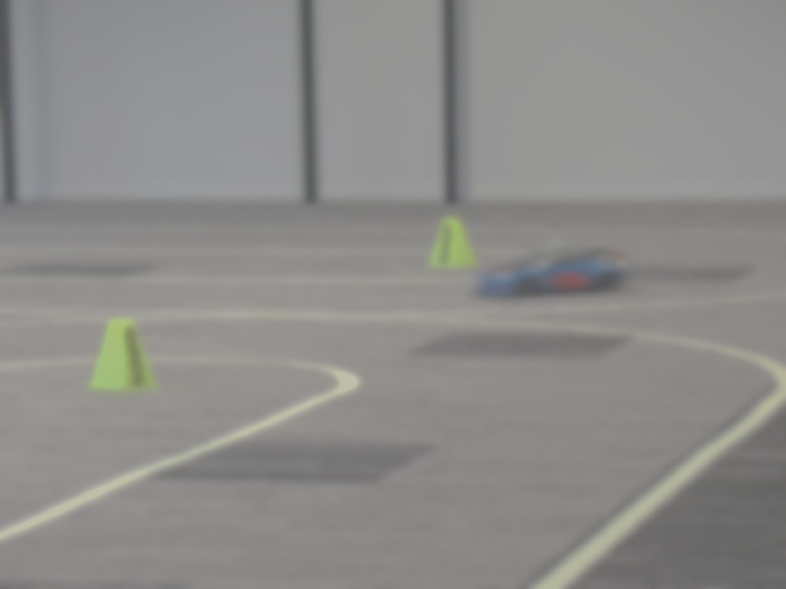
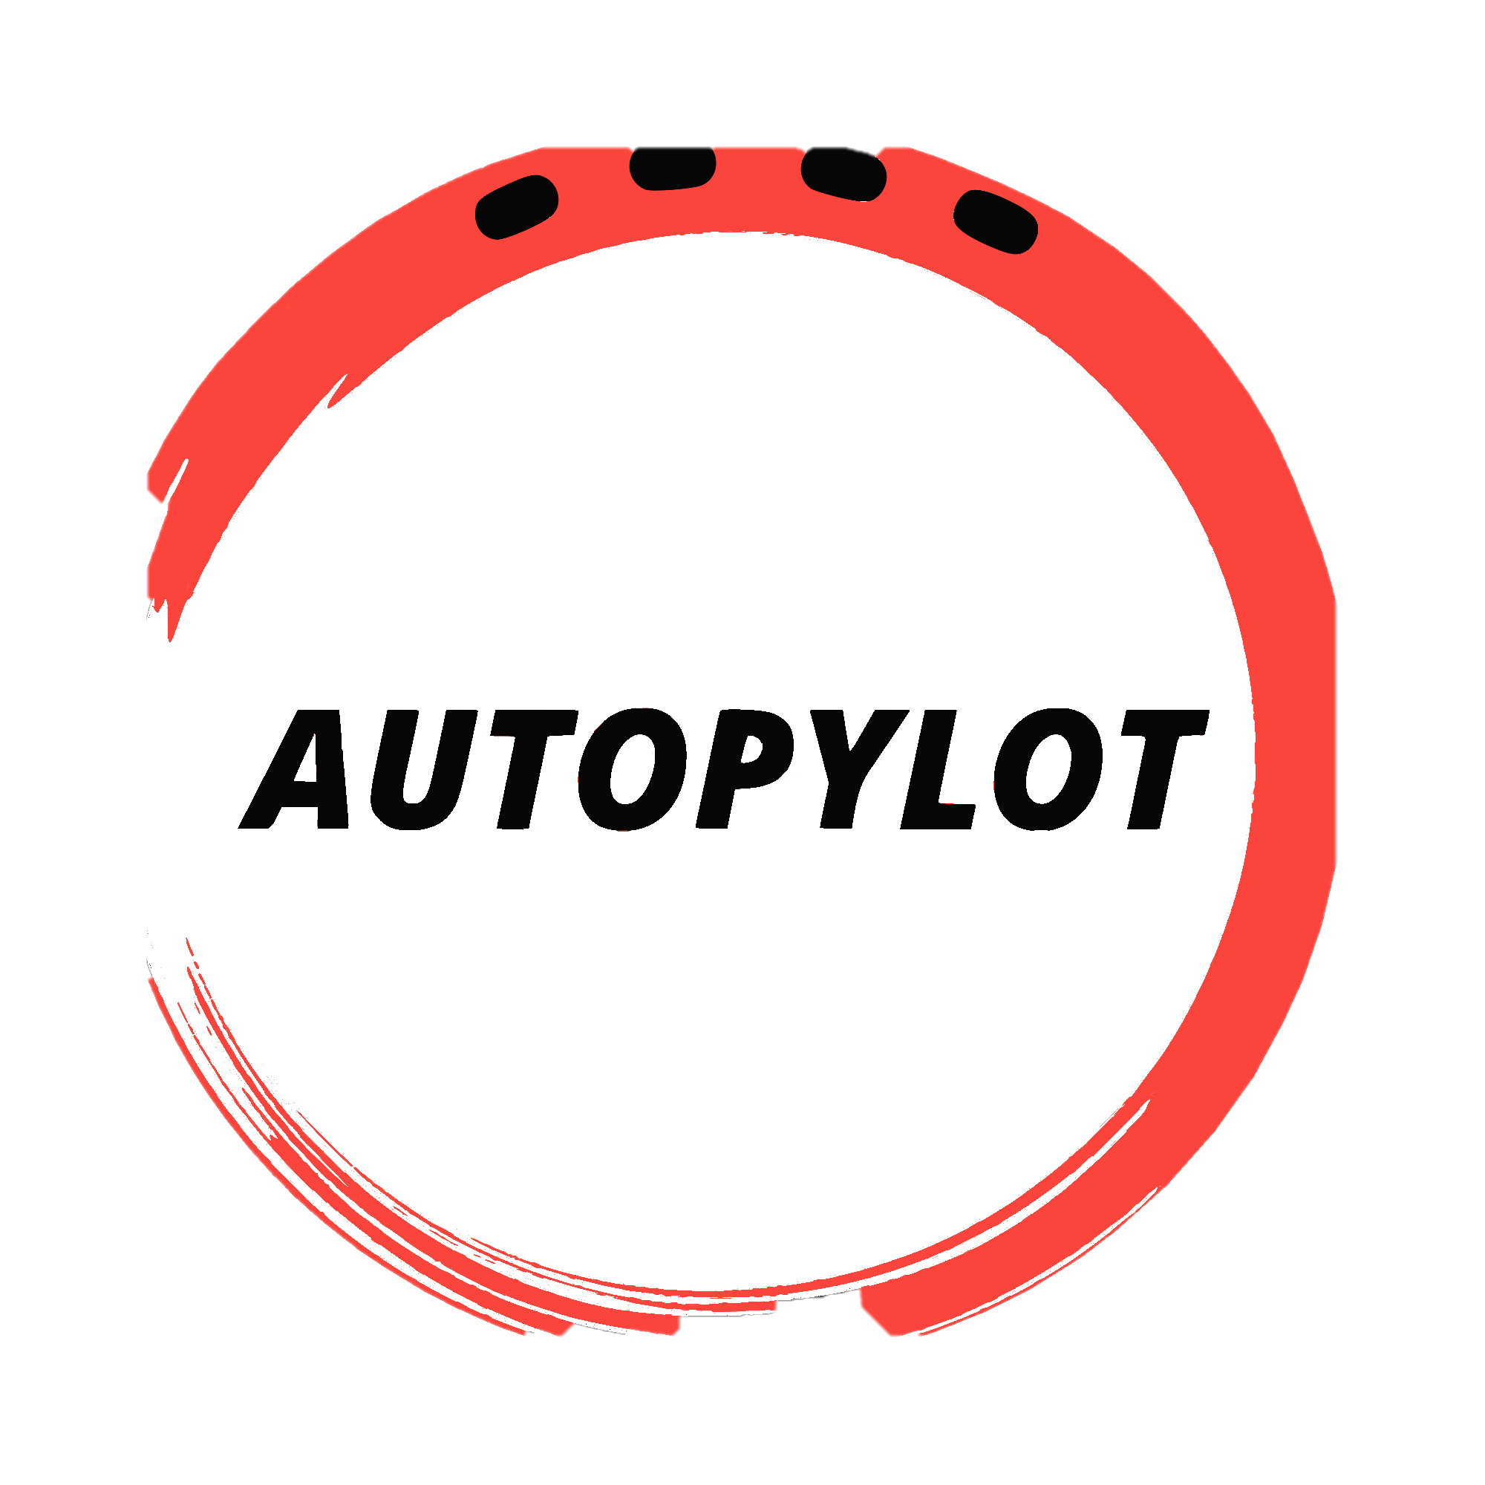
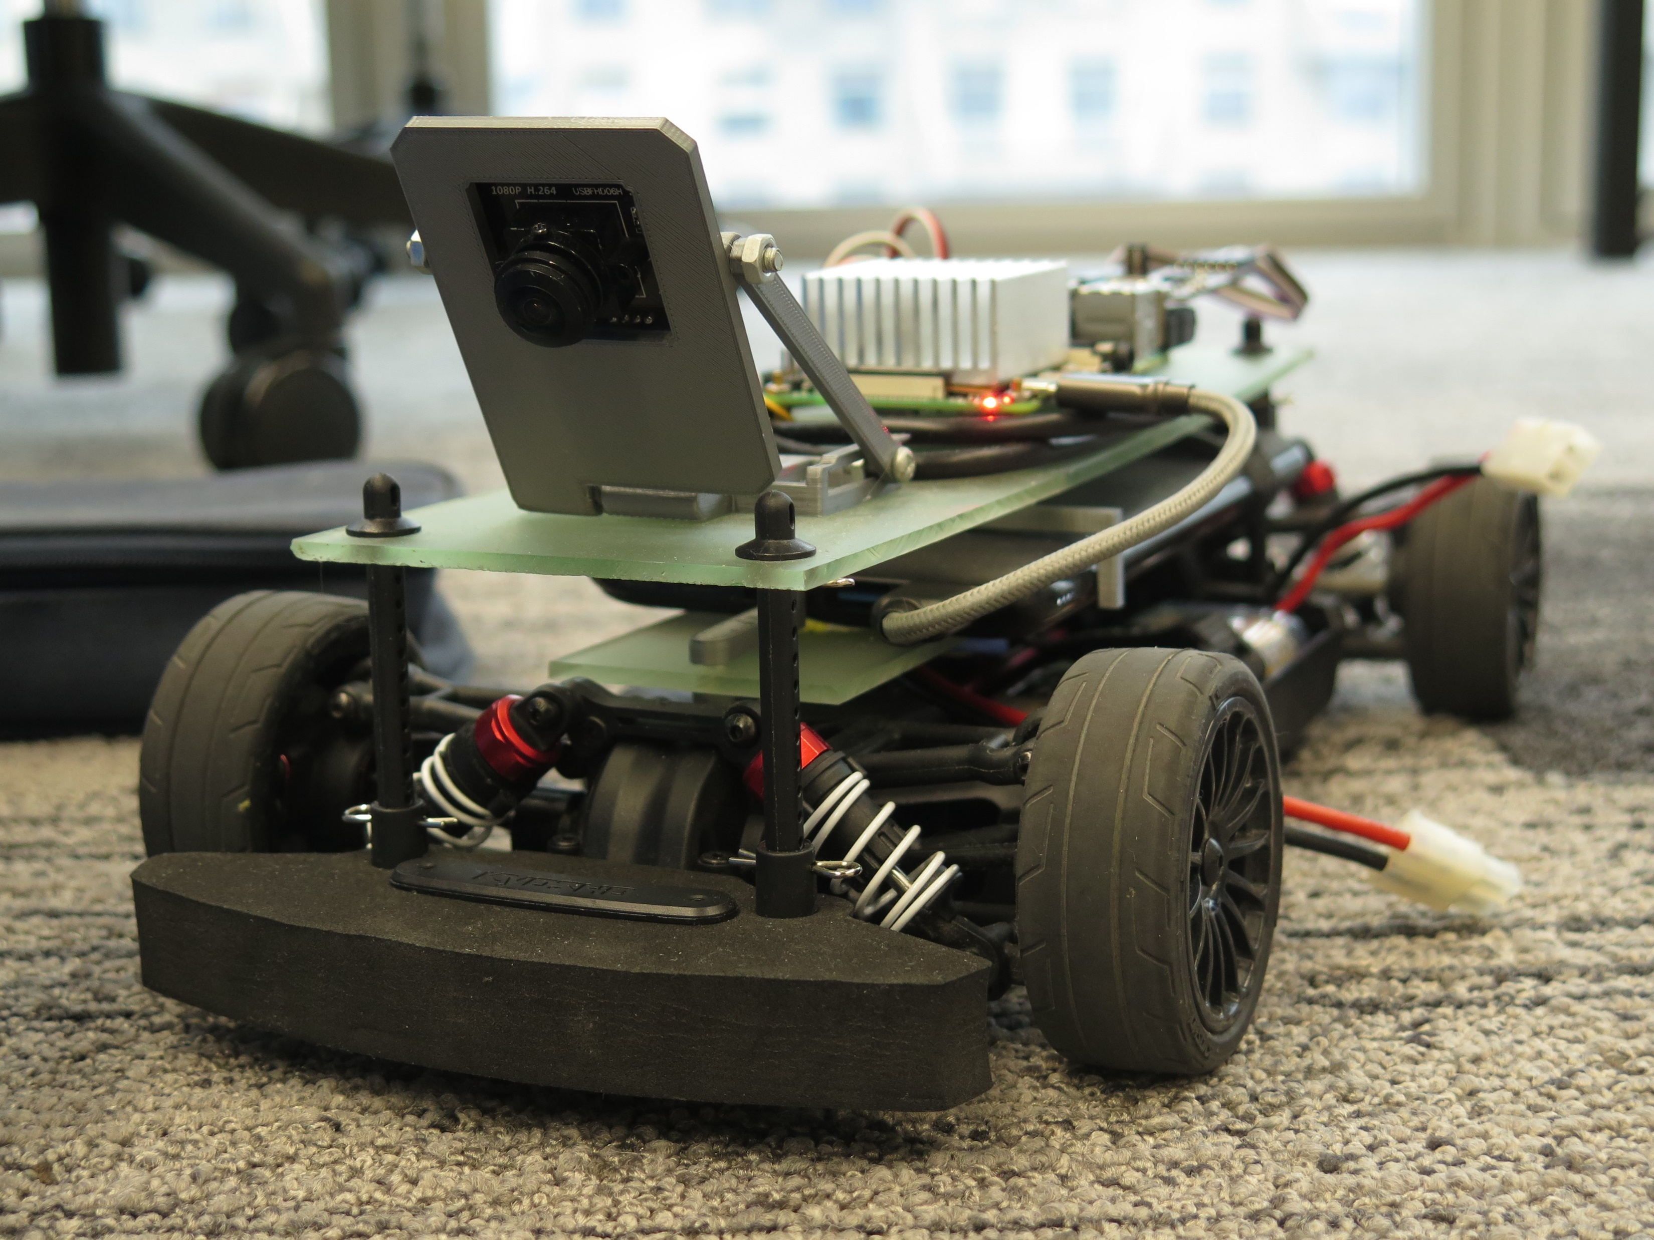
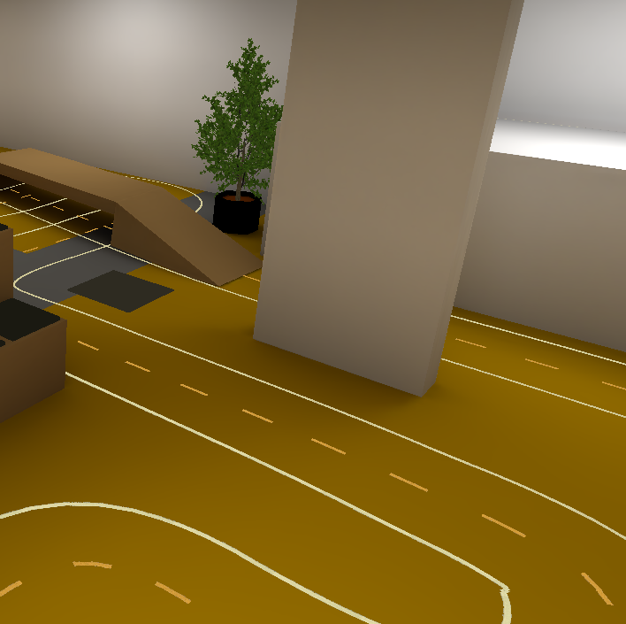
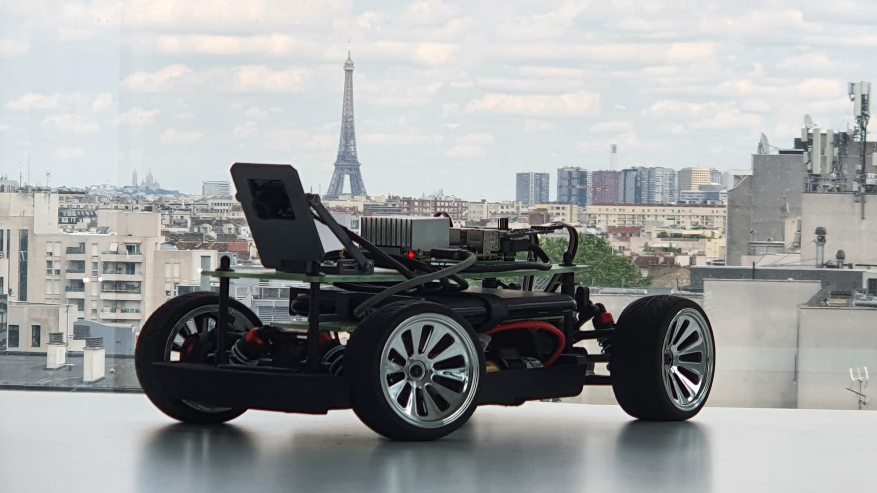

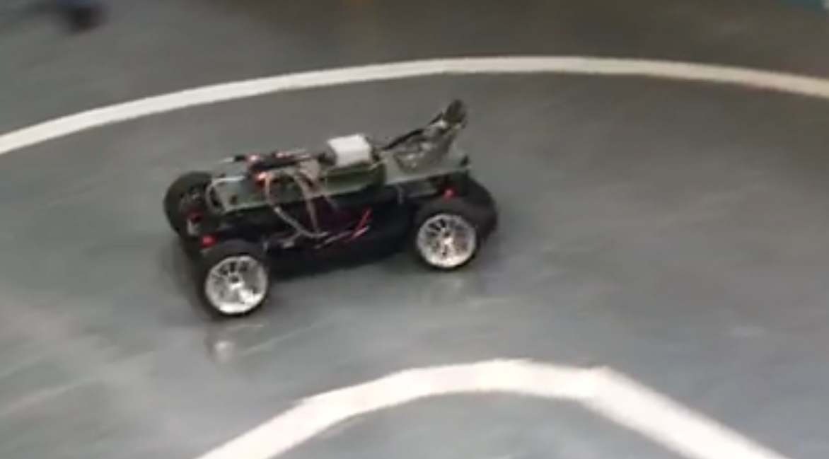
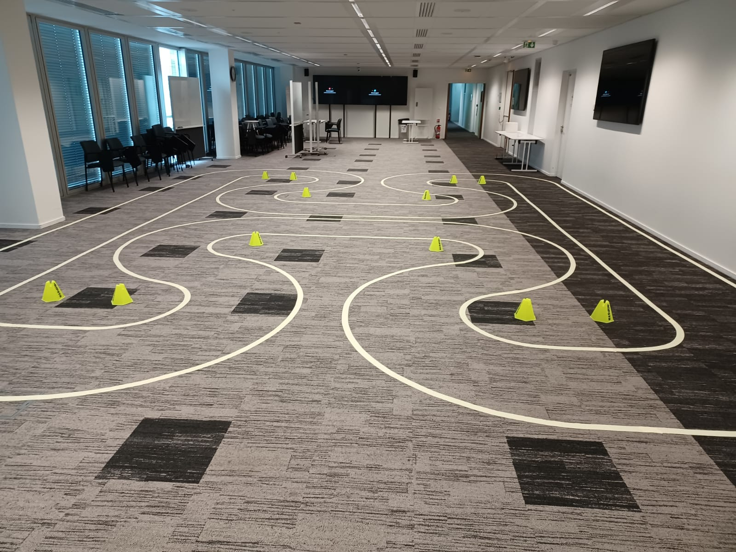

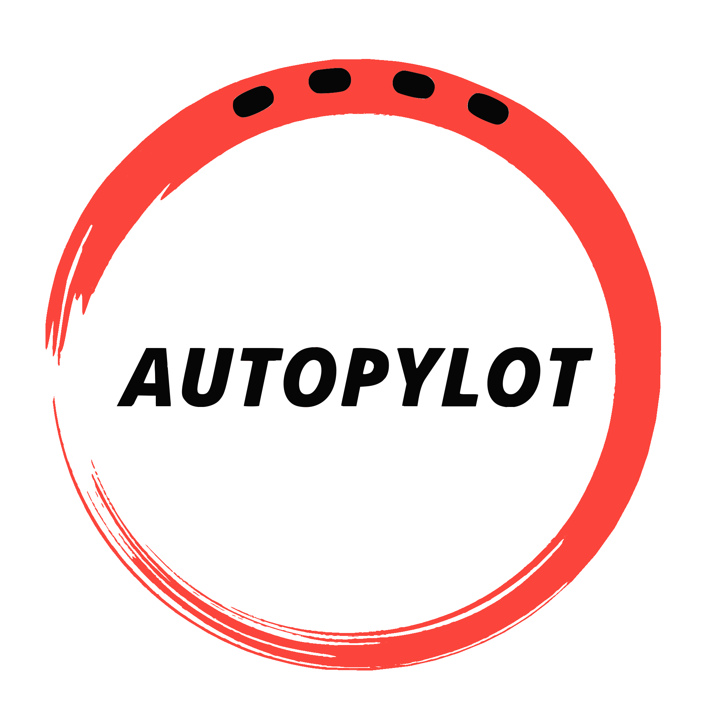



Amazing autonomous driving experience with 26 years of research and development at your finger tips ● Only 5 pages of instructions ● Simulator ● Live camera streaming ● Data generation tool
- Racing Edition
Have fun not driving your car !
“AutoPylot is the best way to learn python and coding while racing !” Elon Musk
“Drives better than Max Verstappen” Sir Lewis Hamilton
Recommended configuration: RC car ● Windows, Linux, MacOS ● Raspberry PI 3+ with Raspbian ● Arduino ● Cables ● Ironing station ● Patience ● Fun ● USB Camera ● Xbox controller ● Internet connection
By Autonomobile

